Slide 1
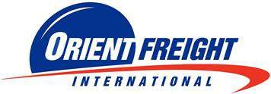
CORPORATE PRESENTATION

Slide 2


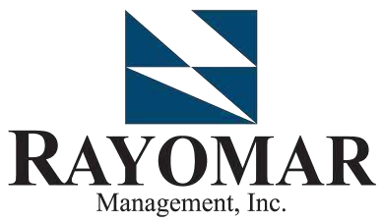




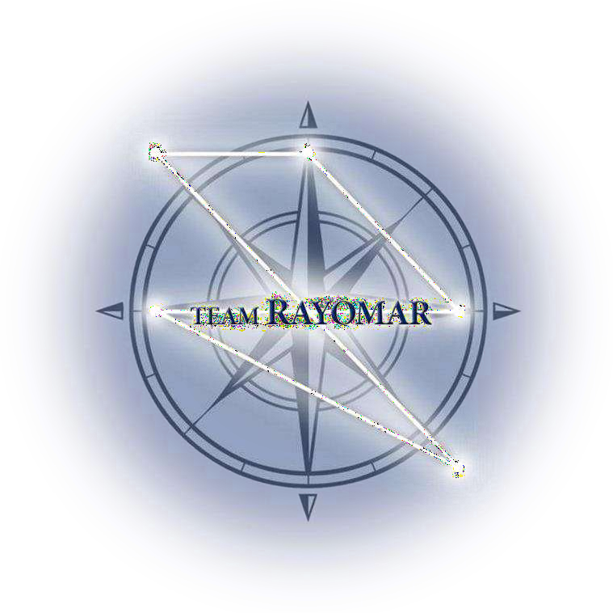













RAYOMAR GROUP OF COMPANIES

Slide 3
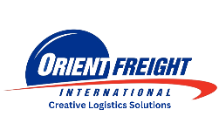
Orient Freight – Vision, Mission, Core Values
Our Mission :
To ensure Total Customer Satisfaction by providing efficient, reliable, economical and innovative logistics and multi-modal transport services
Our Commitment :
Total Customer Satisfaction by providing Quality Service
Our Vision:
To become the recognized industry leader in Creative Logistic Solutions
Our Core Values:
Respect
Creativity
Integrity
Passion
Teamwork
”CREATIVE LOGISTIC SOLUTIONS”

Slide 4
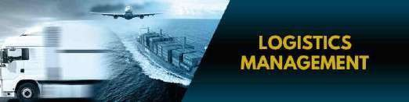
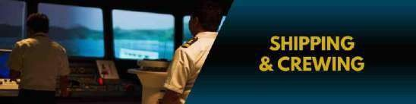
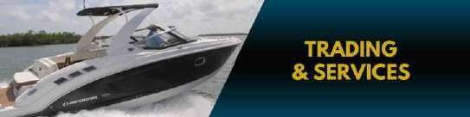






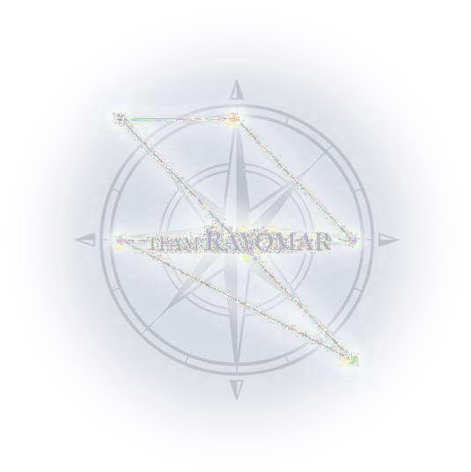










OFII Services and Capabilities

Slide 5
Orient Freight Milestones
Established as a Licensed Customs Broker
Land Transportation
Warehousing
Container Yard
Airfreight Forwarding
Sea freight Forwarding
Logistics Management
Project Cargoes
Domestic Distribution
Certified under ISO 9001 Quality Management System
1973
1980
1984
1990
1997
Auto Logistics
Car Carrier Haulage
Agri Logistics
Customs Clearance
Warehousing
Infra Logistics
Customs Clearance
Project Cargo
Cold Chain
Transportation
Warehousing
Hub & Spoke
Nationwide distribution – air, sea, RoRo
Non-Commercial Logistics
Customs Clearance
Domestic Distribution
Last Mile Delivery
2024 -2025
”CREATIVE LOGISTIC SOLUTIONS”

Slide 6
























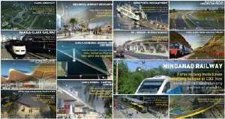





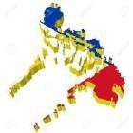
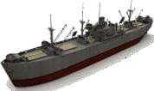




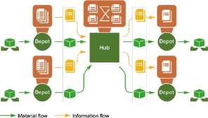
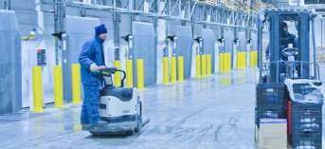


OFII Services and Capabilities
Established in 1973 as a corporation and a licensed customs broker and freight forwarder, specializing in cargo transportation and allied services.
Our Commitment:
Our Vision:
Our Mission:
To ensure total customer satisfaction by providing efficient, reliable, economical and innovative logistics and multimodal transport services.
TOTAL CUSTOMER
To become the recognized industry leader in Creative Logistics Solutions.
SATISFACTION
providing
SERVICE
by
QUALITY
2000
2017
2022
2027...
Logistics Management
Sea Freight
NVOCC
Forwarding
Air Freight Forwarding
Customs
Brokerage
Domestic
Distribution
Supply Chain Management
Our Services and Moving Forward:

Slide 7









OFII Services and Capabilities
Complete and “Creative Logistic Solutions”
Suppliers (Origin)
Sea/Air Freight Customs Brokerage
Customized and customer-centric end to end logistic solution
Pick up from origin in any part of the globe
Shipping via sea or air freight regardless of INCOTERMS
Clearing shipments in any major ports / airports in the Philippines including trucking
Store goods in OFII warehouses including value added services. Warehouse management services
Trucking
Delivery to ultimate consignee even in the remote areas
Ultimate Customer
Partners - Waste
Mgt. Companies
Warehouse
Reverse logistics i.e. disposal and delivery back to origin in any part of the globe

Slide 8





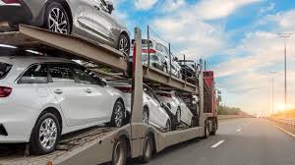
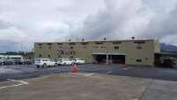
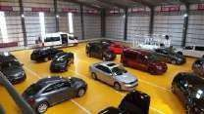




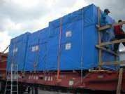
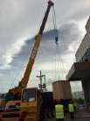
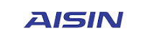








OFII Services and Capabilities
Customs Brokerage Services for Regular Import and Export, 3PL, Trucking, Tariff Consultation & Customs Declaration
Auto-Logistics Service
K-Line Auto-Logistics
Transshipment Services for PEZA, Freeport Zones and Customs Bonded Warehousing
In-plant Services for Import and Export, Documentation, Container Inventory Management
In-plant Logistics Service
Special Project Cargoes
Project Cargo Handling, Custom Clearance and Delivery
Special Cargo and Bulk Cargo
Customs Clearance/Brokerage
Carrier Delivery Services
In-plant and onsite logistics services
Notes:
Updated In-plant log services (removed Schneider)

Slide 9





OFII Services and Capabilities
AIR FREIGHT FORWARDING
Multi IATA Direct Loading
Global coverage thru RGLN Network and Tandem Global Logistics
(Comprehensive Global Network with RGLN and Tandem Global partnership)
Door-to-door/Express Service
Business partnership with major airlines and forwarder
(Continuously obtain best rate and service package with major airlines with guaranteed space).
Time definite airfreight delivery at competitive pricing
(Partnership with major and reliable airlines and forwarder for better pricing and space commitment).
Airfreight Customs Clearance
Participates in RFQs or Global bidding process
(Actively supports biddings for small and big clients, both for global and regional requirements).
DG Cargo Handling
Provide spot quotes outside the normal bidding process
(Monitors market and provide spot quotes due to changing market)
Provide 3PL services
(Ex: Trucking, Documentation Management & Processing, Warehousing, Packing & Crating
Third-Party Logistics
Notes:
also in partnership with Tandem Global Logistics

Slide 10













OFII Services and Capabilities
SEA FREIGHT FORWARDING
Global coverage thru RGLN Network
(Comprehensive Global Network with RGLN partnership)
NVOCC (Non-Vessel Operating Common Carrier
Business partnership with major ocean carriers
(Signs contracts with major ocean carriers for better pricing and space allocation)
Consolidation and Deconsolidation
(Performs consolidation and deconsolidation; provide cost analysis for LCL and FCL )
3rd Party Logistics (Origin Vendor / P.O. Management)
End to end cargo Visibility
(Provides shipment milestones thru the Hellmann Portal- a real time, web-based portal solution)
Report and KPI Management
(Provides reports and data analytics
Special Freight Handling (Commercial and Non- Commercial Cargo

Slide 11


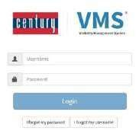
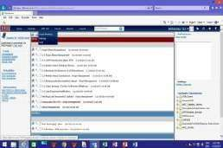
OFII Services and Capabilities
SEA FREIGHT FORWARDING
Vendor Management
(Manage compliance in: production, booking, cargo load, cargo delivery, documents, etc.)
NVOCC (Non-Vessel Operating Common Carrier
Purchase Order Management
(Manage accuracy on actual PO shipped vs planned down to SKU level, real time booking and shipment visibility, etc.)
Booking Management
(Manage compliance in carrier allocation & loadability. Perform forecast with carriers.)
Cargo Receiving Management
3rd Party Logistics (Origin Vendor / P.O. Management)
(Monitor accuracy & timeliness on cargo condition, labeling/scanning, cargo info., etc.)
Container Loading Management
(Optimize container load, equipment mix & cargo mix, loading guides compliance, security, etc.)
Cargo Shipping Management
(Monitor carrier performance and booking acceptance)
Special Freight Handling (Commercial and Non- Commercial Cargo
Document Management
(Manage vendor document collection, checking, verification, sorting & distribution, etc.)

Slide 12

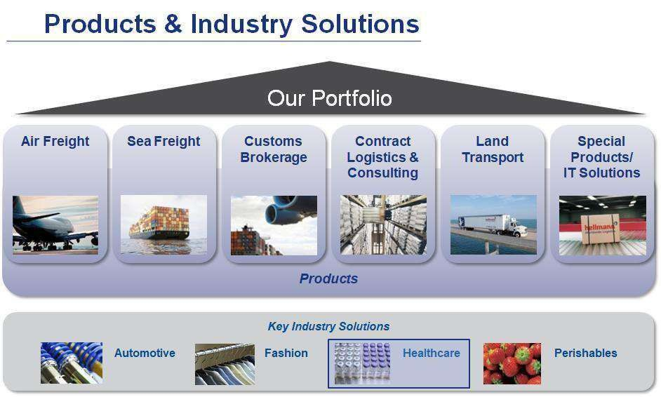




OFII Services and Capabilities
SEA FREIGHT FORWARDING
NVOCC (Non-Vessel Operating Common Carrier
3rd Party Logistics (Origin Vendor / P.O. Management)
Special Freight Handling (Commercial and Non- Commercial Cargo
Non-Commercial Freight (Household Goods & Personal Effects

Slide 13


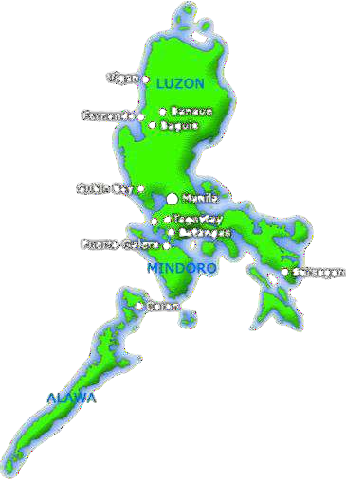





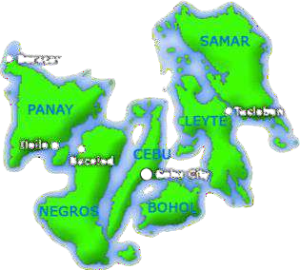




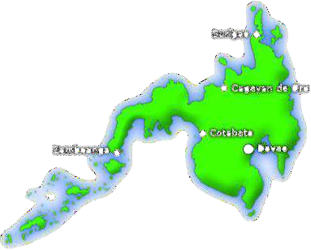



OFII Services and Capabilities
DOMESTIC DISTRIBUTION SERVICES
Trucking
Domestic Forwarding
Warehousing
Value Added Services - Pick and
Pack, Assembly, Sorting, Labelling

Slide 14

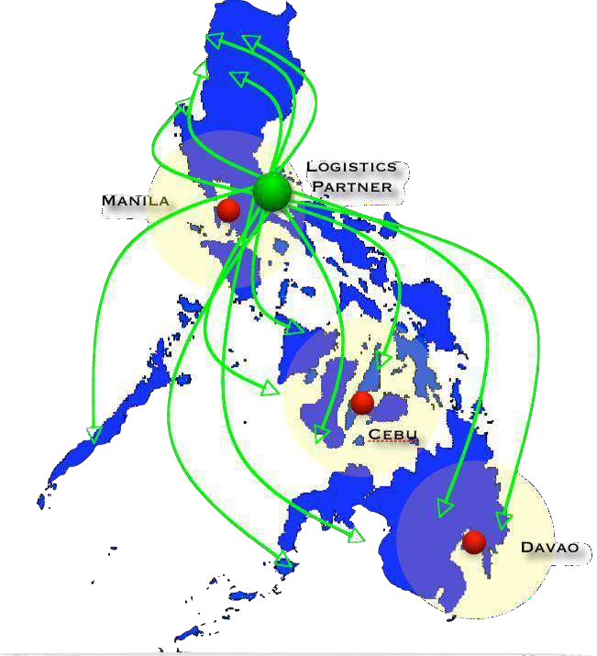







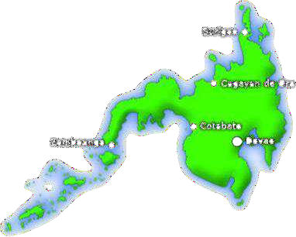

OFII Services and Capabilities
DOMESTIC DISTRIBUTION SERVICES
Trucking
Around 851 stores nationwide 10 - 15 projects per month
Domestic Forwarding
Manila to Cebu/Davao then Inter-Island Deliveries
Warehousing
Value Added Services - Pick and
Pack, Assembly, Sorting, Labelling

Slide 15
OFII Services and Capabilities
DOMESTIC DISTRIBUTION SERVICES
4,000 SQM Located at Carmona, Cavie
Trucking
4,500 pallet positions - Ambient
500 pallet positions - controlled temperature room
Domestic Forwarding
Manned by security guards 24/7 with surveillance cameras inside and outside facility perimeter.
Stripping/Unloading
Storage (ambient and controlled temperature rooms) Cross docking
Value Added Services:
Labelling Bundling/Kitting Crating
Warehousing
Value Added Services - Pick and
Pack, Assembly, Sorting, Labelling

Slide 16
OFII Services and Capabilities
DOMESTIC DISTRIBUTION SERVICES
Trucking
KPIs - 98% -100% Hit Rate
Inventory Accuracy
Domestic Forwarding
Order Fill Rate
Delivery Performance
Warehousing
Value Added Services - Pick and
Pack, Assembly, Sorting, Labelling
Document Return Performance
Document Countering Performance

Slide 17
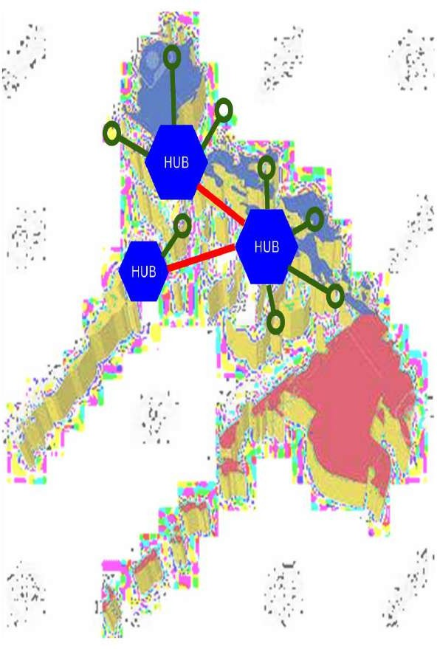
OFII Services and Capabilities
Trucking
Wider hub and spoke through partnership
Domestic Forwarding
Warehousing
Value Added Services - Pick and
Pack, Assembly, Sorting, Labelling

Slide 18







OFII Services and Capabilities
VISMIN DIVISION
Brokerage and Customs Releasing
Cebu
Unit 905 Cebu Holding Center, Cardinal Rosales Ave., Ayala Business Center, Cebu City
Davao
Unit 5 Bldg 1 cor Malagamot Road Panacan, Davao City
Sea-freight Import and Export
Iloilo
Rm6 2F Luis Hervas Bldg., Ledesma St, Iloilo City Proper, Iloilo City, Iloilo
Cagayan De Oro
3F Alpha Business Complex, Baloi, Brgy. Talon, Cagayan de Oro City
Airfreight Import and Export
General Santos
Door E Rostrell Building, National Highway, Calumpang, General Santos City
Off-Dock Container Yard Station
Local Warehousing and Forwarding

Slide 19



CFS Services & Capabilities
Total Warehouse Area & Capacity
Total warehouse area – 1,362 sqm; Can handle 800 pallet positions
Distance to the Port
Around 4-6 Kilometers away from Manila Ports
Inventory Management Systems (IMS)
Warehouse Management System (WMS)
Finance and Accounting
System and Visibility Tools
Security
Security guards on 24/7; 43 CCTV cameras, burglar alarm system
Manpower
With a total of Eighteen (17) manpower
”CREATIVE LOGISTIC SOLUTIONS”

Slide 20
Our Services & Capabilities
Warehousing
We provide cost effective long and short term bonded storage, consolidation and deliveries. Our CFS ensures that cargoes are secured 24/7.
Import Deconsolidation
Containers that are not yet cleared from Customs are moved to our CFS for stripping and cargoes are sorted based on P.O’s, SKUs, Carton Markings etc. as required by the customers
Cross Docking & Transloading
Cross-docking services can be performed in the CFS where movement of goods are transported immediately from one location to another.
Export Consolidation
Cargoes for export are loaded into the container following the client’s loading instruction and requirements. (fumigation, crating, palletization, plastic wrapping, labelling)
Container Drayage
We provide container pick-up from the port to our CFS and container return to carrier’s container yard within the free time allowed by the carrier.
”CREATIVE LOGISTIC SOLUTIONS”

Slide 21
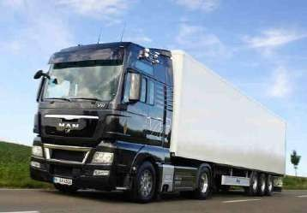


MANILA TRANSPORT GROUP
OFII Services and Capabilities
Average 150 trips / day
Hustling
Office located at 2F Myers Building, Cor.
R.S. OCA & A.C. Delgado St., South Harbor, Port Area, Manila
Hauling

Slide 22
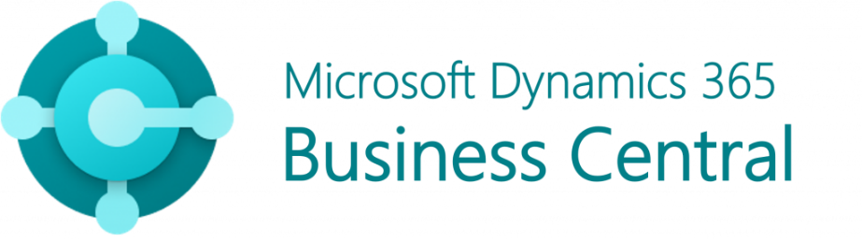

Systems and Visibility Tools
Warehouse Management System
Finance & Accounting
Track & Trace
”CREATIVE LOGISTIC SOLUTIONS”

Slide 23
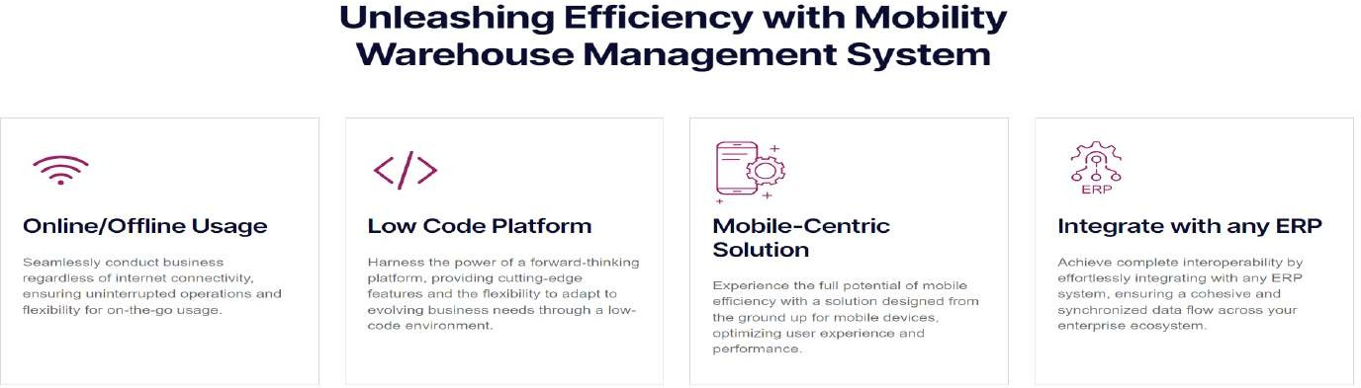
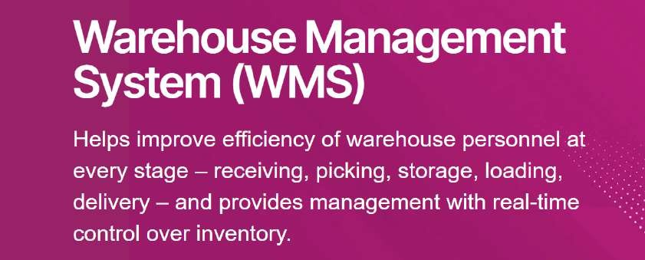
I.T. TOOLS:
Simplr WMS

Slide 24




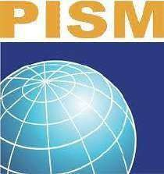


Certification and Accreditation:
ISO 9001:2015 and ISO 14001:2015 Certified by TUV Rheinland. We have upgraded our Quality Management System and recently passed the audit for ISO 9001:2015 version.
CTPAT compliant warehouse facilities. Member of:
IATA (International Air Transport Association)
PMTLAI (Philippine Multi-modal Transport and Logistics Association, Inc.)
ACOP (Association of CFS Operators of the Philippines)
CTAP (Confederation of Truckers Association of the Philippines)
PISM

Slide 25
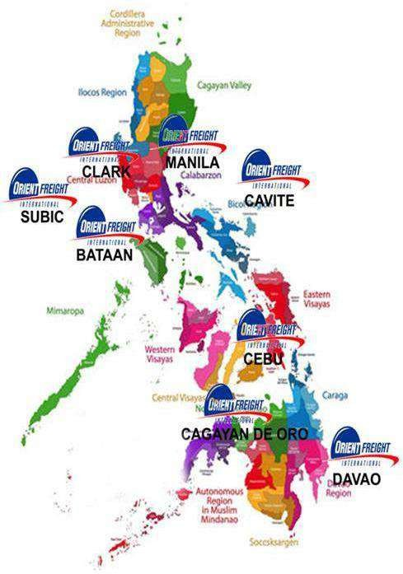
ORGANIC OFFICES AND WAREHOUSES
Head Office:
4th & 8th Floors Country Space 1 Bldg. Sen Gil Puyat Ave. Makati City Philippines
DDS Warehouse
LYL Business Industrial Park, Governor’s Drive, Brgy. Bancal Carmona, Cavite
CFS Warehouse
Warehouse 5 P. Correa St. Paco Manila
Transport
Room 203 Myers Building, Corner R.S Oca & A.C Delgado St. South Harbor, Port Area, Manila
North
Unit 122-123 Bldg Central Business District Area, Subic Bay , Wow Complex Central, Bus'n District Rizal Highway Subic Bay Freeport Zone Philippines
Cebu
Unit 905 Cebu Holding Center, Cardinal Rosales Ave., Ayala Business Center, Cebu City
Iloilo Office
Rm6 2F Luis Hervas Bldg., Ledesma St, Iloilo City Proper, Iloilo City, Iloilo
Cagayan De Oro (C.D.O)
3RD Floor Alpha Business Complex, Baloi, Barangay Tablon Cagayan de Oro City
Gensan
Door E Rostrell Building, National Highway, Calumpang, General Santos City
Davao
Unit 5 Bldg 1 cor Malagamot Road Panacan, Davao City

Slide 26

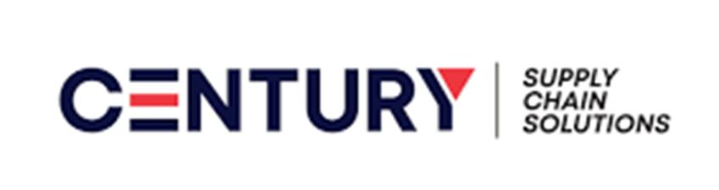
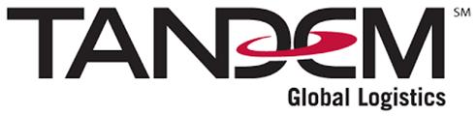
Our Key Partners:

Slide 27
Thank you!

